Slide 1
D-311 Unit 8: Basic Initial Attack Aircraft

Slide 2
Objectives
Identify and discuss characteristics of common tactical aircraft.
Match common tactical missions with the appropriate aircraft
Identify and discuss what a SAFECOM is and how they are used.
Identify methods of flight following

Slide 3
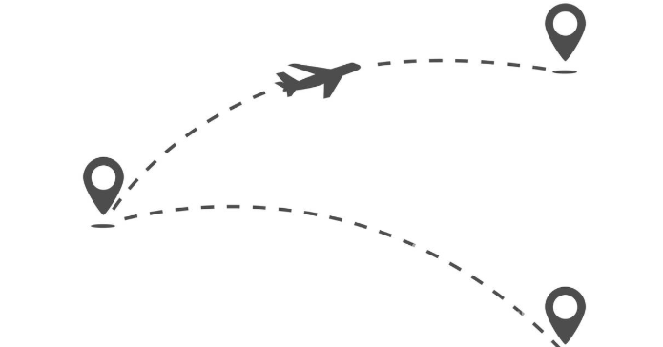
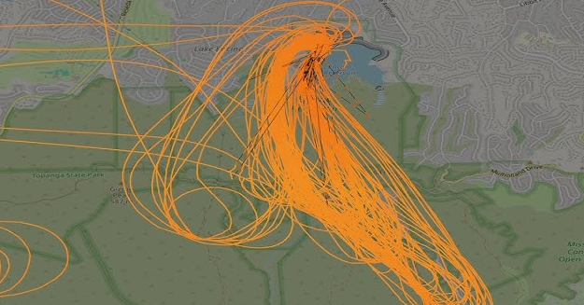
Determine the Flight Mission
Point to Point (General)
Mission Flights (Special Use)

Slide 4
Misson Flights (Special Use)
What are some examples of mission flights?
Water/ retardant application
Parachute delivery application
Aerial supervision
Helitack / Rappelling
Reconnaissance
Aerial ignition
Aerial capture, eradication
Tagging animals
External load operations
Aerial survey
Paracargo

Slide 5
Flight Types
Tactical
Non-tactical (logistics flights)
Administrative (point to point)
Non-administrative
(mission/special use)

Slide 6
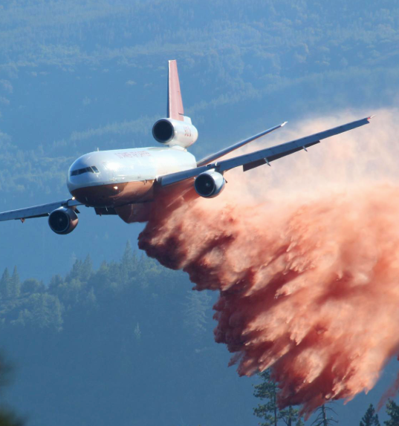
Tactical
What are some examples of tactical resources?
Air Tankers – Retardant
Smoke Jumpers
Lead Planes
Air Attack
Bravo / Kilo
Rappel Operations
Helitack Operations

Slide 7
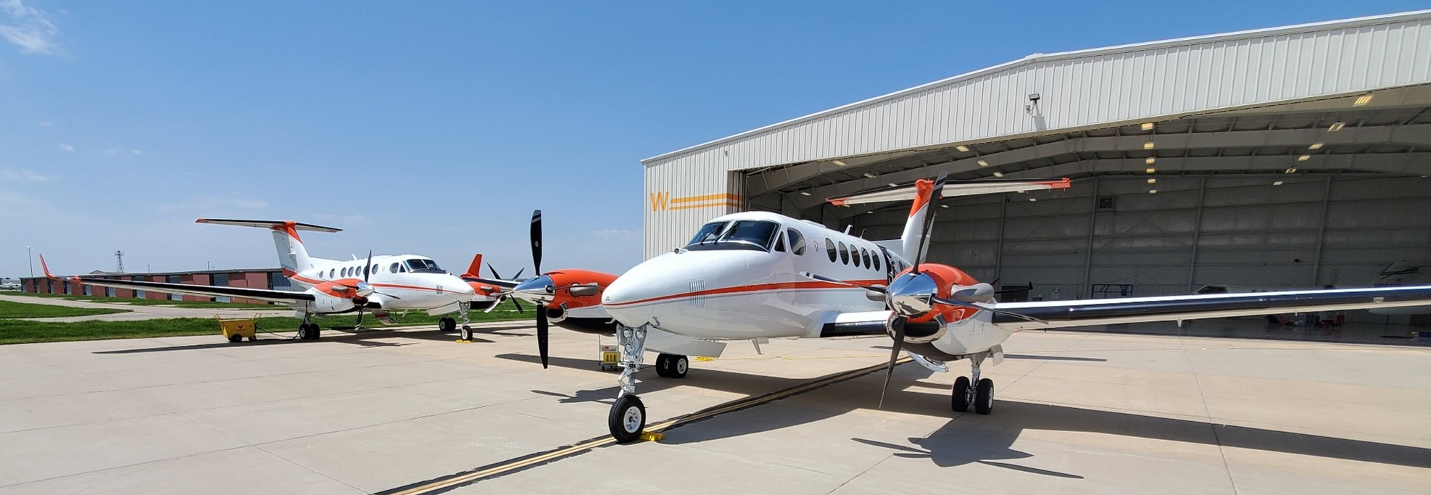
Non–Tactical
Logistical Flights
Aircraft activities that support fire suppression operations.
Delivery of fire personnel and cargo to incident.
Mobilization of aircraft needed to support incident operations.
Infrared flights including Large Fire Mapping, historically known as NIROPS and day IR Flights.

Slide 8
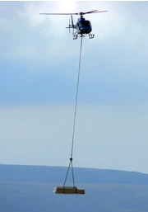
Administrative vs. Non-Administrative
Point to Point Flight
Administrative
Mission/Special Use
Non-Administrative
Flights that meet the point-to-point flight definition.
Transportation of authorized passengers and cargo.
Flight requires cost analysis and agency approval process.
Any non-fire suppression flight that meets the point-to-point flight definition.
Flights require agency approved project plan.

Slide 9
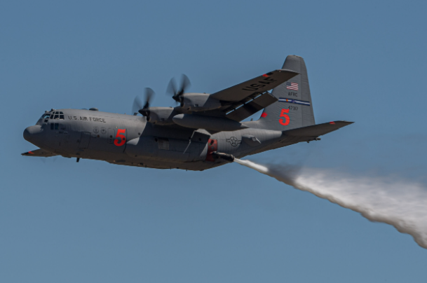
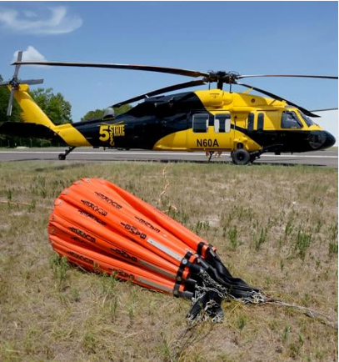
Aircraft Sources
Exclusive Use
Call-when-needed (CWN)
Agency-owned
Military (when activated)
Cooperative Aircraft
MATOC

Slide 10
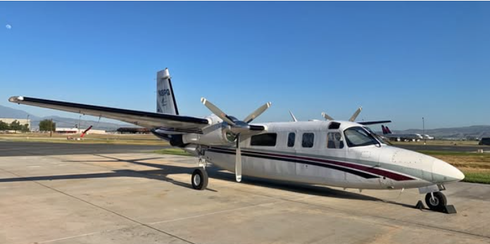
Functions of Aerial Supervision
On scene air traffic manager
Safety observer for ground personnel
Recommends aircraft needs
Recommends temporary flight restrictions (TFR)
Develops and implements communications plan
Makes tactical and logistical recommendations

Slide 11
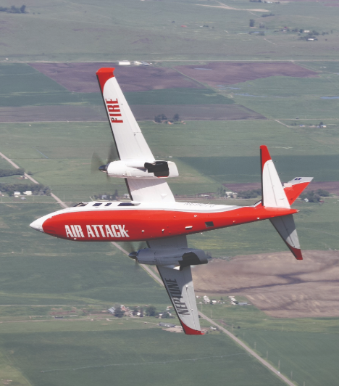
Aerial Supervision
What situations would require aerial supervision?
Answer:
Congested airspace
Multiple aircraft over incident
Canadian or modular aerial firefighting systems (MAFFS)
Adverse conditions (visibility, terrain, weather)
Air tanker pilot requests a lead plane
Air tanker pilot not initial attack rated.

Slide 12
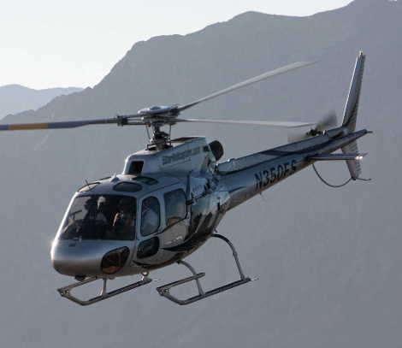
Aerial Supervision
What positions may perform as aerial supervision?
Answer:
Air tactical group supervisor (ATGS)
Aerial Supervision Module (ASM)
Lead Plane (LEAD)
Helicopter Coordinator (HLCO)

Slide 13
Flight Following
The knowledge of the location and condition of an aircraft with a reasonable degree of certainty such that, in the event of a mishap those on board may be rescued.
Implement flight following procedures according to agency requirements. Identify and implement local procedures.

Slide 14
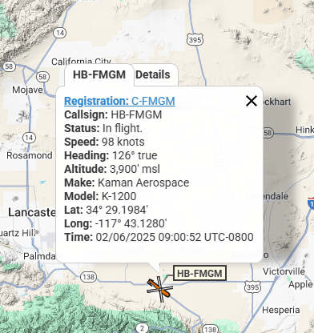
Flight Following
What are some methods of flight following?
Agency check-ins
Automated Flight Following (AFF)
Flight plan

Slide 15
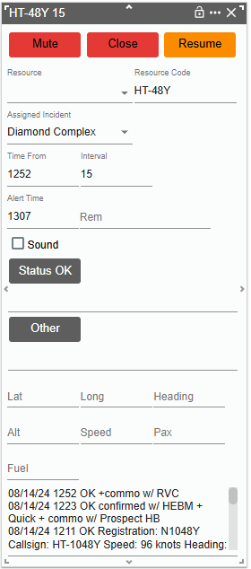
Dispatch Tools for Flight Following
Flight schedule
Radio logs
Computer Aided Dispatch System (CAD)

Slide 16
Flight Following
What information needs to be gathered for effective flight following?
Answer:
Itinerary- actual time of departure (ATD) and estimated time of departure (ETD)
Method of flight following
Number of personnel on board
Destination
Flight route
Fuel on board
Pilot name, company name, and phone number
Tail number and color of aircraft

Slide 17
Flight Plan Close Out Methods
Positive communication via radio or telephone from the pilot or chief of party/flight manager at destination
Positive confirmation of the aircraft being passed or “handed off” to another unit.

Slide 18
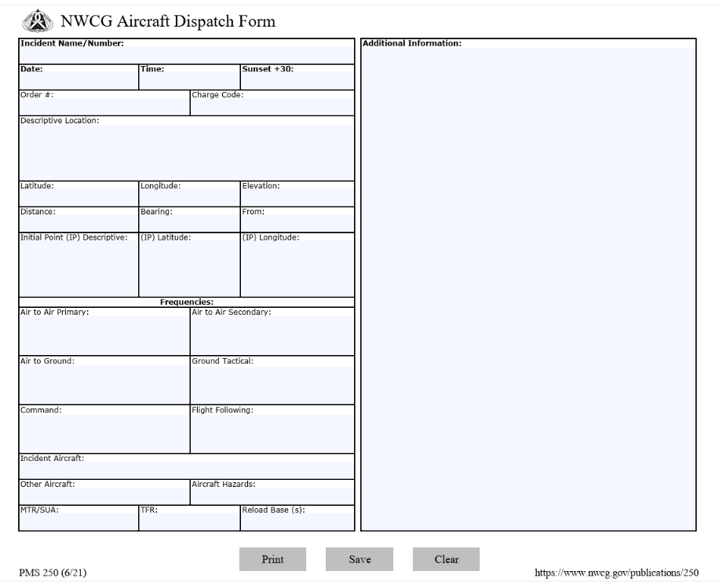
NWCG Aircraft Dispatch Form

Slide 19
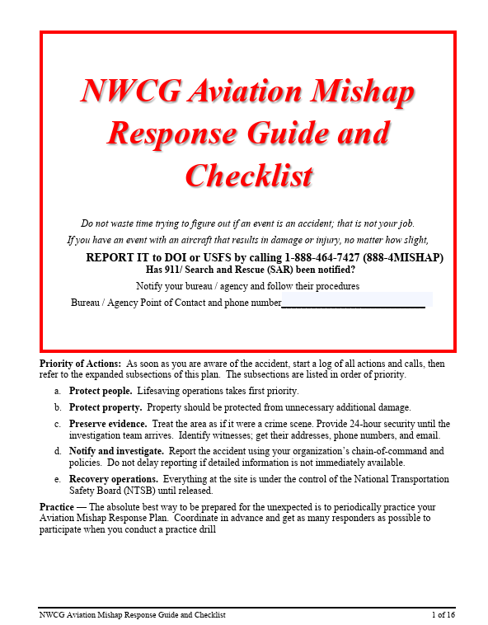
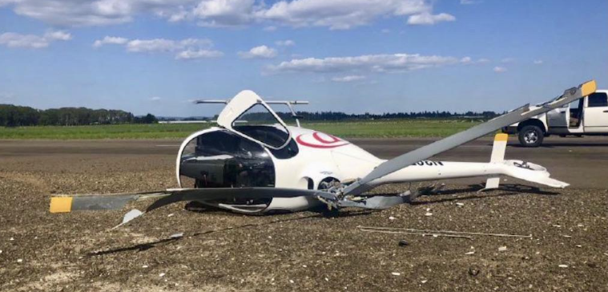
Aviation Mishap Guide
NWCG Aviation Mishap Response Guide and Checklist

Slide 20
Aviation Mishap Types
Overdue Aircraft
Time | Action | Contact and Phone
Immediately at time aircraft is due | Attempt to contact aircraft by radio or phone. If equipped, review Automated Flight Following (AFF) data. Contact destination agency airbase or airport. Gather info required for Aircraft Accident Checklist.
15 minutes past due | Contact originating or en route agency dispatch. Contact originating or en route agency airbase. Contact originating or en route airports.
30 minutes past due | Contact vendor home base. Contact the FAA / Lockheed-Martin Flight Service. Station and request an Alert Notice (ALNOT). | 1 800 992-7433 (800 WX BRIEF) – Select “1” to speak to a briefer. Give the briefer the info and your contact info. The briefer will notify the “Hub” supervisor who will notify the FAA. Expect a return call for more info.
Possible Missing Aircraft

Slide 21
Aviation Mishap Types
Possible Missing Aircraft
Time | Action | Contact and Phone
Anytime the fuel duration is exceeded or if an aircraft is missing/and an accident is suspected. | Submit data from the Aircraft Accident Checklist to: FAA / Lockheed-Martin Flight Service Station and request an Alert Notice (ALNOT) or contact the FAA Regional Operations Center. Notify OAS /USFS Aviation Safety Office. Notify Local Aviation Manager. | 1 800 992-7433 (800 WX BRIEF) List of centers are on the reverse side. 1 888 464-7427 (888-4MISHAP) **

Slide 22
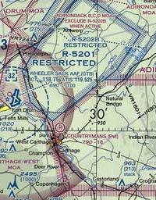
Special Use Airspace (SUA)
Airspace where activity must be confined because of its nature and/or limitations may be imposed upon aircraft operations that are not part of those activities.
The purpose of a SUA is to identify for other airspace users where military activity occurs, segregate that activity from other users to enhance safety, and to allow charting to keep airspace users informed.

Slide 23
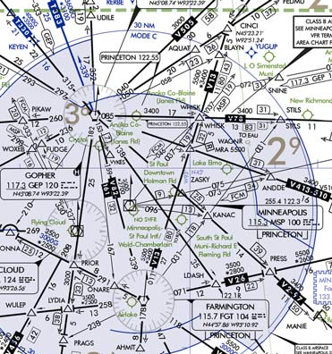
Military Training Routes (MTR’s)
Routes provided for military training
Types of Military Routes
  Slow routes (SRs)
  Low altitude tactical navigation areas (LATNs)
  Aerial refueling routes (ARs)
  Visual flight routes (VFR)
  Instrument flight routes (IFR)

Slide 24
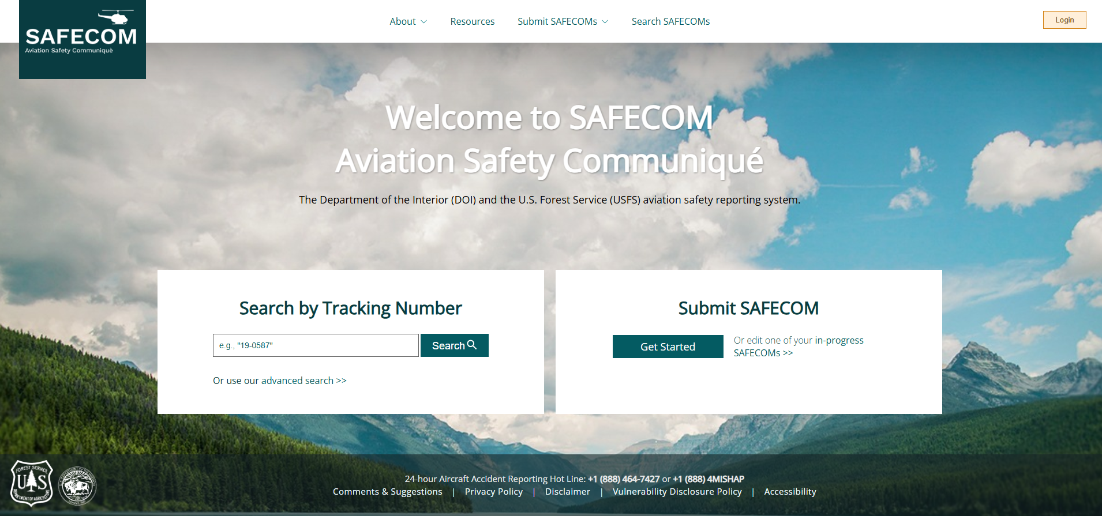
SAFECOM
Website: http:www.safecom.gov/

Slide 25
Objective Summary
Identify and discuss characteristics of common tactical aircraft.
Match common tactical missions with the appropriate aircraft
Identify and discuss what a SAFECOM is and how they are used.
Identify methods of flight following
Notes:
Guides and Key
The presentations and instructor guides include notes to aid facilitators in instruction.
Key
Indicates an action for the instructor to take.
Indicates topics and information for the facilitator to use as they see fit.
Example Notes
Review unit objectives.
Exercise
Advise participants that the next few slides will introduce common terms that describe parts of a fire.
Pre-Video Discussion
In this scenario, firefighters have arrived on scene of a new fire. They are gathering and communicating their situational awareness of the current fire behavior.
Play Video
Title Basic Fire Terminology
Summary State the summary
Time (02:20)
Audio
Post-Video Discussion
This unit will discuss many of these terms in more detail.
Question: Identify this fire behavior.
Answer: Torching
Note to Instructor
The fuel types listed on this slide will be discussed in detail in Unit 2.
List Level 1
List Level2
Example
Example
List Level 1
List Level 1

